Slide 1
Do Stricter Firearm Control Laws Reduce Firearm Mortality?
Data 608- Story 3
-YINA QIAO

Slide 2
Do Stricter Firearm Control Laws Reduce Firearm Mortality?
Study Purpose: Investigates the impact of firearm control laws on mortality rates due to gun violence across various states.
Key Question: Do stricter firearm control laws help reduce firearm mortality?
Methodology Overview: Analyzes CDC API data to explore the relationship between gun law stringency and gun deaths.
Data 608- Story 3
-YINA QIAO

Slide 3
Do Stricter Firearm Control Laws Reduce Firearm Mortality?
Data Utilized: Firearm mortality data per 100k persons from the CDC using an available API https://open.cdc.gov/apis.html and gun law rank data complied https://giffords.org/lawcenter/resources/scorecard2022/?scorecard=HI#every-state-ranked
Data 608- Story 3
-YINA QIAO

Slide 4
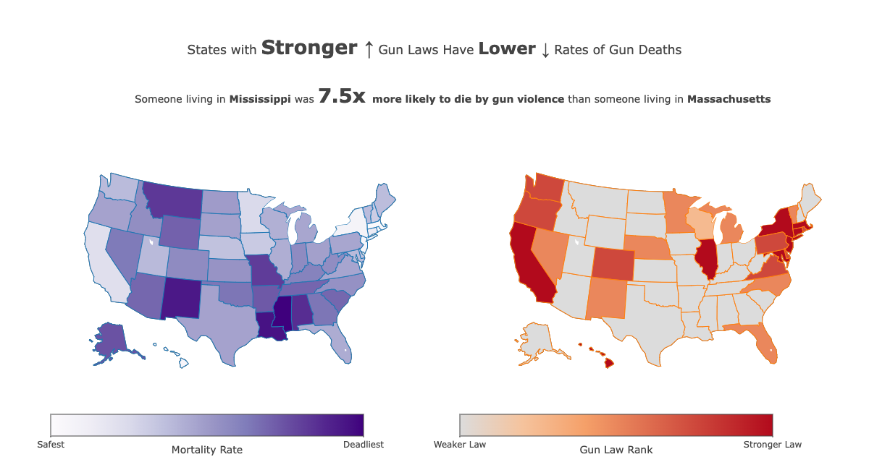




MA:3.8
MS:28.8

Slide 5
Conclusion
Do Stricter Firearm Control Laws Reduce Firearm Mortality?
Gun law
Gun Death
Gun law
Gun Death
Final Thoughts: Overall, it seems that states with stronger gun laws have lower rates of gun violence. Stronger gun laws could be an effective measure in reducing gun violence deaths.

